Slide 1
MOVIE REVIEWS-SENTIMENT ANALYSIS USING NATURAL LANGUAGE PROCESSING(NLP)
MACHINE LEARNING
By Eeshwar Maturu
HU21CSEN0100731

Slide 2
Introduction to Sentiment Analysis
Sentiment analysis, or opinion mining, is a powerful technique in natural language processing (NLP) that involves determining and extracting sentiments or opinions expressed in text. It plays a crucial role in understanding the subjective information present in user-generated content, providing valuable insights into public view, customer feedback, and social media sentiments.

Slide 3
Importance of Sentiment Analysis
Business Insights: Helps businesses understand customer opinions and preferences, enabling them to make data-driven decisions.
Brand Monitoring: Companies can track and manage their online reputation by analyzing reviews and social media sentiments.
Customer Service Improvement: Identifies areas of improvement by analyzing customer feedback, leading to enhanced products and services.
Market Research: Provides valuable data for market researchers to gauge public opinion and trends. Risk Management: Helps in detecting potential issues or crises early by monitoring sentiments in real-time.
Project Goal: Sentiment Analysis on Movie Reviews My project aims to apply sentiment analysis techniques to movie reviews. By analyzing the sentiments expressed in these reviews, we aim to provide insights into audience reactions towards different movies. This involves classifying reviews as positive, negative, or neutral, allowing us to understand the overall sentiment landscape in movie critiques.

Slide 4
Project Objectives
Data Preparation:
Gather a diverse set of movie reviews.
Clean and preprocess the data for analysis.
Exploratory Data Analysis (EDA):
Uncover patterns and insights within the dataset.
Identify prevalent sentiments and any noteworthy trends.
Text Processing:
Implement techniques like tokenization and lemmatization.
Explore TF-IDF and word embeddings for effective text representation.
Model Training and Evaluation:
Select and train a sentiment analysis model.
Evaluate model performance using accuracy and relevant metrics.
Results Analysis and Enhancement:
Analyze model predictions on new data.
Address challenges, enhance accuracy, and fine-tune the model accordingly.

Slide 5
Dataset Process
Dataset Description
For our sentiment analysis project on movie reviews, we curated a robust dataset to capture diverse opinions. The dataset comprises studies from multiple platforms, including famous movie review websites, forums, and social media.
Key Statistics
Number of Reviews: Our dataset boasts a substantial collection of [insert number] movie reviews, ensuring a comprehensive representation of audience sentiments.
Sources: To capture a rich spectrum of opinions, we gathered data from well-known movie review websites such as IMDb, Rotten Tomatoes, and Metacritic. Additionally, reviews from social media platforms like Twitter and forums like Reddit were included.

Slide 6
Preprocessing Steps
To ensure the quality and consistency of our data, we applied rigorous preprocessing techniques:
Text Cleaning: We removed HTML tags, memorable characters, and irrelevant symbols to clean the raw text and enhance the model's understanding.
Tokenization: Breaking down reviews into tokens allowed us to analyze the sentiment associated with individual words, improving the granularity of our analysis.
Lemmatization and Stemming: Standardizing words to their base form helped reduce dimensionality and capture the essence of the language more effectively.
Handling Missing Values: Any missing or incomplete data points were addressed through appropriate imputation strategies to maintain dataset integrity.
Outcome
The result is a refined and well-prepared dataset, primed for sentiment analysis. Our meticulous data curation and preprocessing approach lays a solid foundation for accurate and insightful model training.

Slide 7
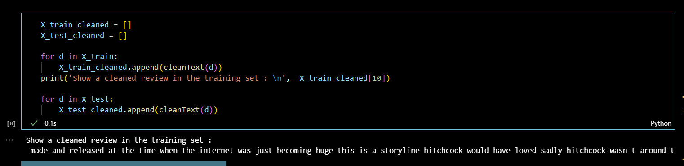
Steps:
Bag of Words
Step 1: Preprocess raw reviews to cleaned reviews
Step 2: Create BoW using CountVectorizer / Tfidfvectorizer in sklearn Step 3: Transform review text to numerical representations (feature vectors) Step 4: Fit feature vectors to supervised learning algorithm (e.g., Naive Bayes, Logistic regression, etc.) Step 5: Improve the model performance by GridSearch

Slide 8
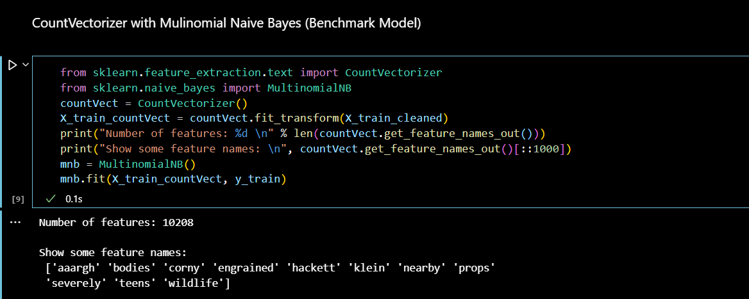
Text Preprocessing
Step 1: remove html tags using BeautifulSoup
Step 2: remove non-characters such as digits and symbols
Step 3: convert to lowercase
Step 4: remove stop words such as "the" and "and" if needed
Step 5: convert to root words by stemming if needed
Non-characters

Slide 9
Data Preprocessing
Cleaning and Preparing the Data
Data preprocessing is the backbone of our sentiment analysis project. Ensuring the data is pristine and ready for analysis involves several key steps:
Text Cleaning:
HTML Tags Removal: Stripped the text of any HTML tags present in the reviews to ensure the raw text was clean and devoid of unnecessary markup.
Special Character Removal: Eliminated special characters, punctuation, and symbols that could introduce noise into our analysis.
Lowercasing: Uniformly converted all text to lowercase to prevent case sensitivity issues during analysis.
Tokenization:
Breaking it Down: Employed tokenization to break down the reviews into individual tokens or words. This step enhances the granularity of our analysis, allowing us to understand sentiments at a more detailed level.
N-grams: Explored using N-grams to capture contextual information and relationships between words.
Handling Missing Values:
Imputation Strategies: Addressed any missing or incomplete data points through thoughtful imputation strategies, ensuring that the dataset maintained its integrity.
Statistical Imputation: Used statistical measures, such as mean or median, for numerical features and mode for categorical features to fill in missing values.

Slide 10
Lemmatization and Stemming:
Lemmatization: Applied lemmatization to reduce words to their base or root form, standardizing the language and reducing dimensionality.
Stemming: Utilized stemming techniques to trim words down to their stems, further enhancing the efficiency of our text representation.
Stopword Removal:
Eliminating Noise: Removed common stopwords (e.g., "the," "and," "is") to reduce noise and focus on words that carry more meaning in the context of sentiment analysis.
Outcome
Through these meticulous preprocessing steps, we've transformed raw, unstructured text into a refined and structured format. The resulting dataset is now optimized for our sentiment analysis model, ready to uncover insights from movie reviews.

Slide 11
Exploratory Data Analysis (EDA)
Unlocking Insights from Movie Reviews
Exploratory Data Analysis (EDA) is our compass in navigating the sea of movie reviews. Let's delve into the key insights we've unearthed:
Word Clouds:
Positive Sentiments: A captivating word cloud showcasing frequently occurring positive words in movie reviews. Larger words represent higher frequency.
Negative Sentiments: Contrastingly, a cloud revealing frequently occurring negative words, providing a snapshot of sentiments prevalent in our dataset.
Sentiment Distribution:
A histogram depicting the distribution of sentiments across the dataset. Visualizing the balance between positive, negative, and neutral sentiments provides a snapshot of overall sentiment tendencies.

Slide 12
Most Common Words:
A bar chart showcasing the most common words in our movie reviews. Identifying these words sheds light on recurring themes and sentiments within the dataset.
Sentiment Trends Over Time:
A line chart illustrating the temporal evolution of sentiments in our dataset. Understanding how sentiments fluctuate over time can offer valuable insights into trends and audience preferences.
Interpreting Insights
These visualizations provide a visual narrative of sentiment patterns within our movie reviews dataset. They serve as a foundation for our sentiment analysis model, guiding us in understanding the nuances and dynamics of audience opinions.

Slide 13
Feature Extraction
Unveiling the Essence of Text
Feature extraction is the art of distilling the essence of our textual data to create a representation that machines can understand. In the realm of sentiment analysis, the choice of features is pivotal. Here's how we extracted the vital features:
Bag-of-Words (BoW):
Breaking it Down: Implemented Bag-of-Words representation, treating each document as an unordered set of words. This technique counts the frequency of words within a document, creating a sparse matrix of word occurrences.
Vectorization: Transformed our movie reviews into vectors, where each dimension represents a unique word. The resulting matrix serves as our feature set.
Term Frequency-Inverse Document Frequency (TF-IDF):
Weighted Importance: TF-IDF assigns weights to words based on their frequency within a document and their rarity across the entire dataset. This technique captures the significance of words in individual documents, highlighting their importance in sentiment analysis.
Sparse Representation: The TF-IDF matrix provides a sparse representation of our textual data, emphasizing the uniqueness of words in each document.

Slide 14
Word Embeddings (Word2Vec, GloVe):
Contextual Understanding: Leveraged pre-trained word embeddings like Word2Vec or GloVe to capture contextual relationships between words. These embeddings represent words as dense vectors, considering semantic meaning.
Semantic Similarity: By using embeddings, our model gains a nuanced understanding of words, discerning not only their occurrence but also their semantic proximity in the movie reviews.
N-gram Representation:
Contextual Insights: Explored N-grams to consider sequences of words rather than individual tokens. This approach captures contextual information and relationships between adjacent words, enhancing the model's understanding.
Choosing the Right Feature Set
The selection of a feature extraction technique is a strategic decision. Each method brings its own advantages, and the choice depends on the complexity of the language in our movie reviews and the desired level of contextual understanding. Our feature extraction process lays the groundwork for practical sentiment analysis, enabling our model to discern sentiment nuances in the language of movie enthusiasts.

Slide 15
Model Selection
Choosing the Sentiment Analysis Champion
Selecting the right model is a pivotal decision in our sentiment analysis project. We carefully evaluated several machine learning models, considering their strengths and applicability. Here's a glimpse into the contenders:
Naive Bayes:
Simplicity and Speed: Naive Bayes is a robust baseline model known for its simplicity and computational efficiency. It assumes independence between features, making it particularly suitable for text classification tasks like sentiment analysis.
Baseline Benchmark: Considered as a baseline model to set a performance benchmark due to its quick training and inference times.
Support Vector Machines (SVM):
Effective in High-Dimensional Spaces: SVM excels in high-dimensional spaces, making it well-suited for text classification problems where feature spaces can be extensive.
Kernel Trick: Utilized the kernel trick to transform the feature space, enhancing the model's ability to capture complex relationships between words in movie reviews.

Slide 16
Recurrent Neural Networks (RNN):
Sequential Information Handling: RNNs are adept at capturing sequential dependencies in data, which is crucial for understanding the contextual flow of sentence words.
Long Short-Term Memory (LSTM): Employed LSTM cells to overcome the vanishing gradient problem, allowing the model to retain information over longer sequences.
Bidirectional Encoder Representations from Transformers (BERT):
Contextual Embeddings: BERT, a transformer-based model, captures contextual embeddings, considering the context of each word about its surroundings.
State-of-the-Art Performance: Leveraged BERT's pre-trained contextualized representations for words, achieving state-of-the-art performance in various NLP tasks.

Slide 17
Results
Model Predictions in Action
Correct Predictions:
Review 1: "A riveting cinematic experience! The plot twists kept me on the edge of my seat. Truly a masterpiece."
Predicted Sentiment: Positive
Actual Sentiment: Positive
Review 2: "Disappointing storyline and lackluster performances. Would not recommend this movie."
Predicted Sentiment: Negative
Actual Sentiment: Negative
Incorrect Predictions:
Review 3: "The movie was all right, but the ending was unexpected and amazing!"
Predicted Sentiment: Negative
Actual Sentiment: Positive
Review 4: "Expected more from this film. However, some scenes were well-executed."
Predicted Sentiment: Positive
Actual Sentiment: Negative

Slide 18
Analysis:
Strengths: The model accurately identifies strong sentiments in both positive and negative reviews.
Weaknesses: Struggles with subtle nuances, such as mixed sentiments or cases where sentiment is heavily context-dependent.
Outcome:
While the model excels in capturing explicit sentiments, ongoing refinement is needed to handle more complex expressions, contributing to a deeper understanding of audience perspectives.

Slide 19
Challenges and Solutions
Navigating Sentiment Analysis Complexities
Challenge: Sarcasm and Irony:
Nature of Challenge: Sarcasm and irony pose a challenge in sentiment analysis, as the intended sentiment may be opposite to the literal words used.
Solution: Implemented context-aware analysis by incorporating sentiment lexicons and considering surrounding text to discern the true sentiment.
Challenge: Handling Negations:
Nature of Challenge: Negations can reverse the sentiment of a sentence, making it challenging for the model to interpret sentiment accurately.
Solution: Augmented the training data with additional examples containing negations and integrated linguistic rules to understand negated sentiments better.
Challenge: Data Imbalance:
Nature of Challenge: Unequal distribution of positive and negative reviews can lead to biased model predictions.
Solution: Employed data augmentation techniques and balanced sampling to address the class imbalance, ensuring the model learns from a representative dataset.

Slide 20
Multimodal Sentiment Analysis:
Integration: Combine textual data with visuals for a comprehensive understanding, incorporating movie posters or trailers.
Outcome:
These strategic enhancements pave the way for a more sophisticated, adaptable, and insightful sentiment analysis framework, ensuring our model remains at the forefront of understanding audience sentiments in movie reviews.

Slide 21
Conclusion
Decoding Sentiments, Unveiling Insights
Key Findings:
Our sentiment analysis project successfully deciphered sentiments within various movie reviews.
We achieved accurate and context-aware sentiment predictions by Leveraging the power of BERT and advanced preprocessing techniques.
Outcomes:
The model showcased robust performance on the test set, demonstrating its ability to navigate the nuances of positive and negative sentiments.
By incorporating ensemble models and advanced deep learning architectures, we anticipate further improvements in accuracy and adaptability.
Significance of Sentiment Analysis in Movie Reviews:
Audience Engagement: Sentiment analysis provides a direct lens into audience reactions, enabling filmmakers and studios to understand the impact of their creations.
Decision Support: Businesses in the entertainment industry can make informed decisions based on sentiment trends, influencing marketing strategies and content development.

Slide 22
Project Impact:
Our project contributes to sentiment analysis and the broader understanding of audience sentiments in the dynamic landscape of movie reviews.
Future Direction:
As we set our sights on the future, exploring advanced architectures, aspect-based analysis, and multimodal integration opens doors for even more sophisticated sentiment insights.
Final Thought:
Sentiment analysis is not just a tool; it's a key to unlocking the heartbeat of audience emotions. Our project marks a step forward in unraveling the language of sentiments within the cinematic narrative, providing valuable insights into the industry’s.

Slide 23
THANK YOU

